Slide 1
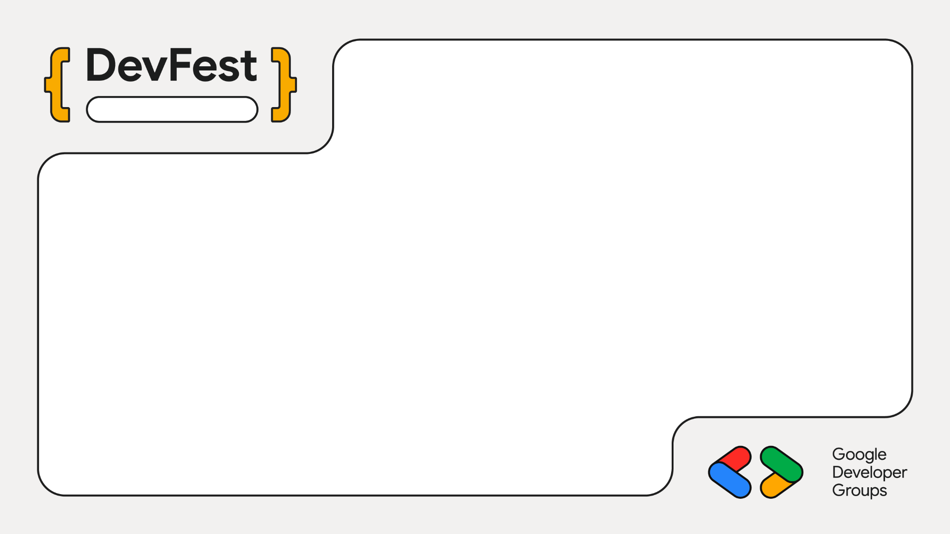
Naya Raipur
Supercharging Documentation with Cloud Run, ADK, and Gemma
Mayur Madnani

Slide 2
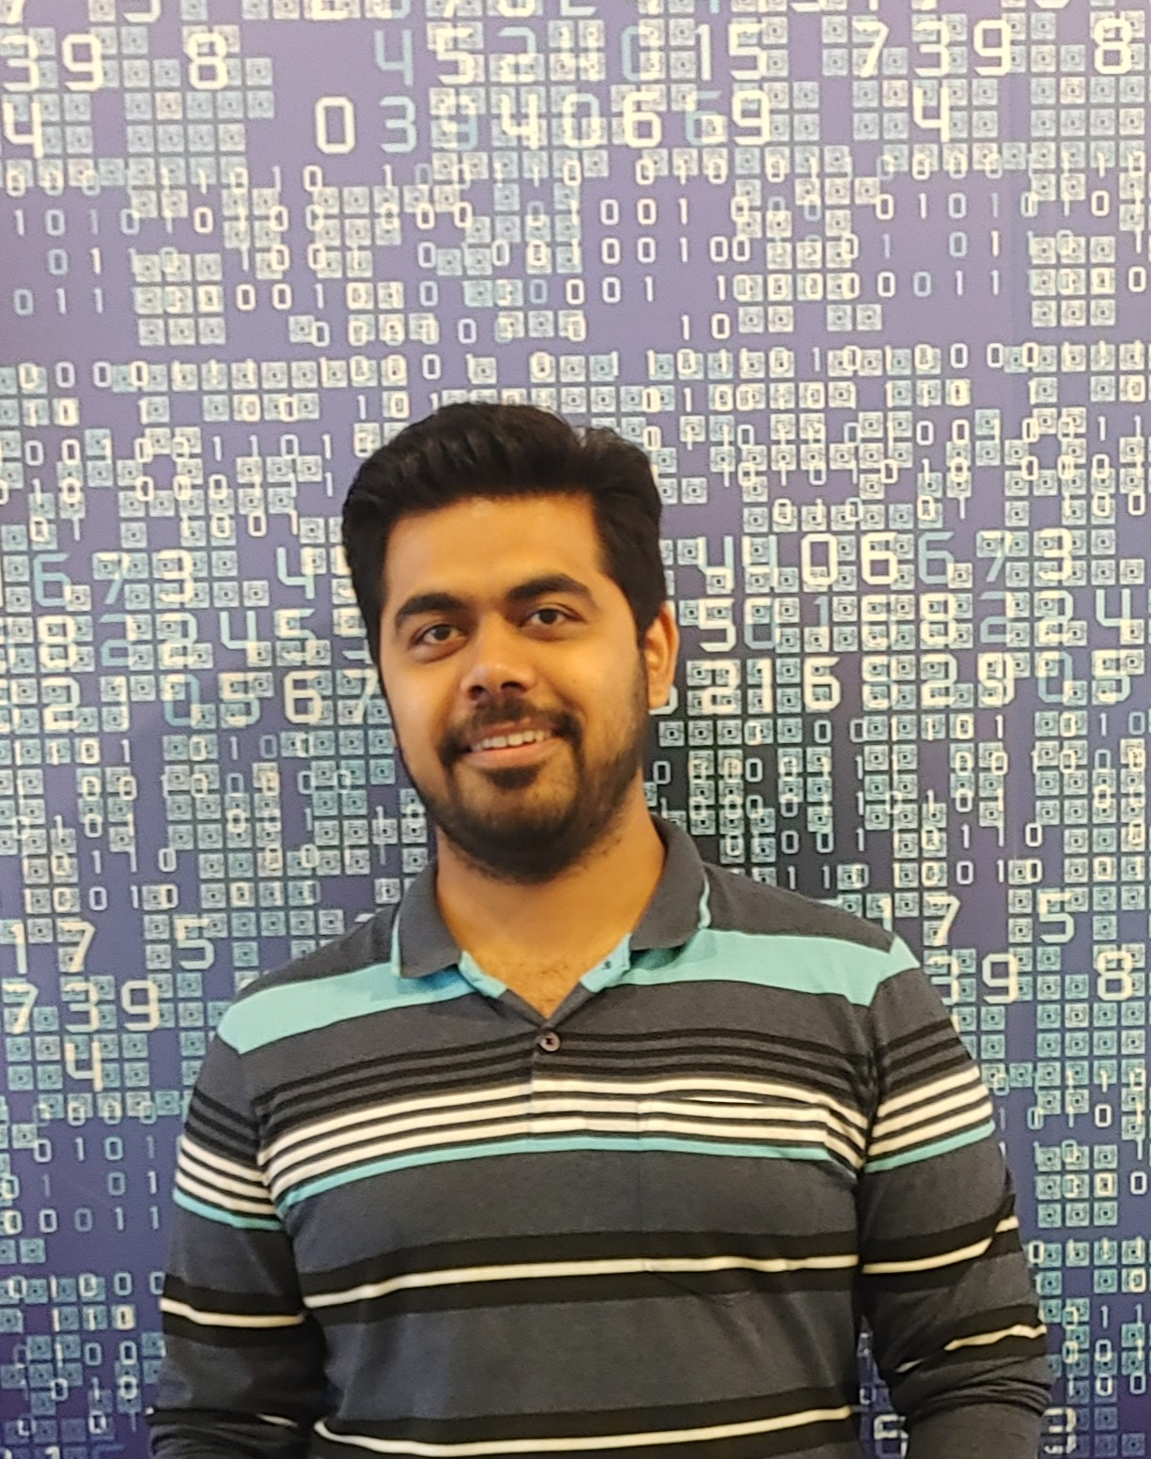
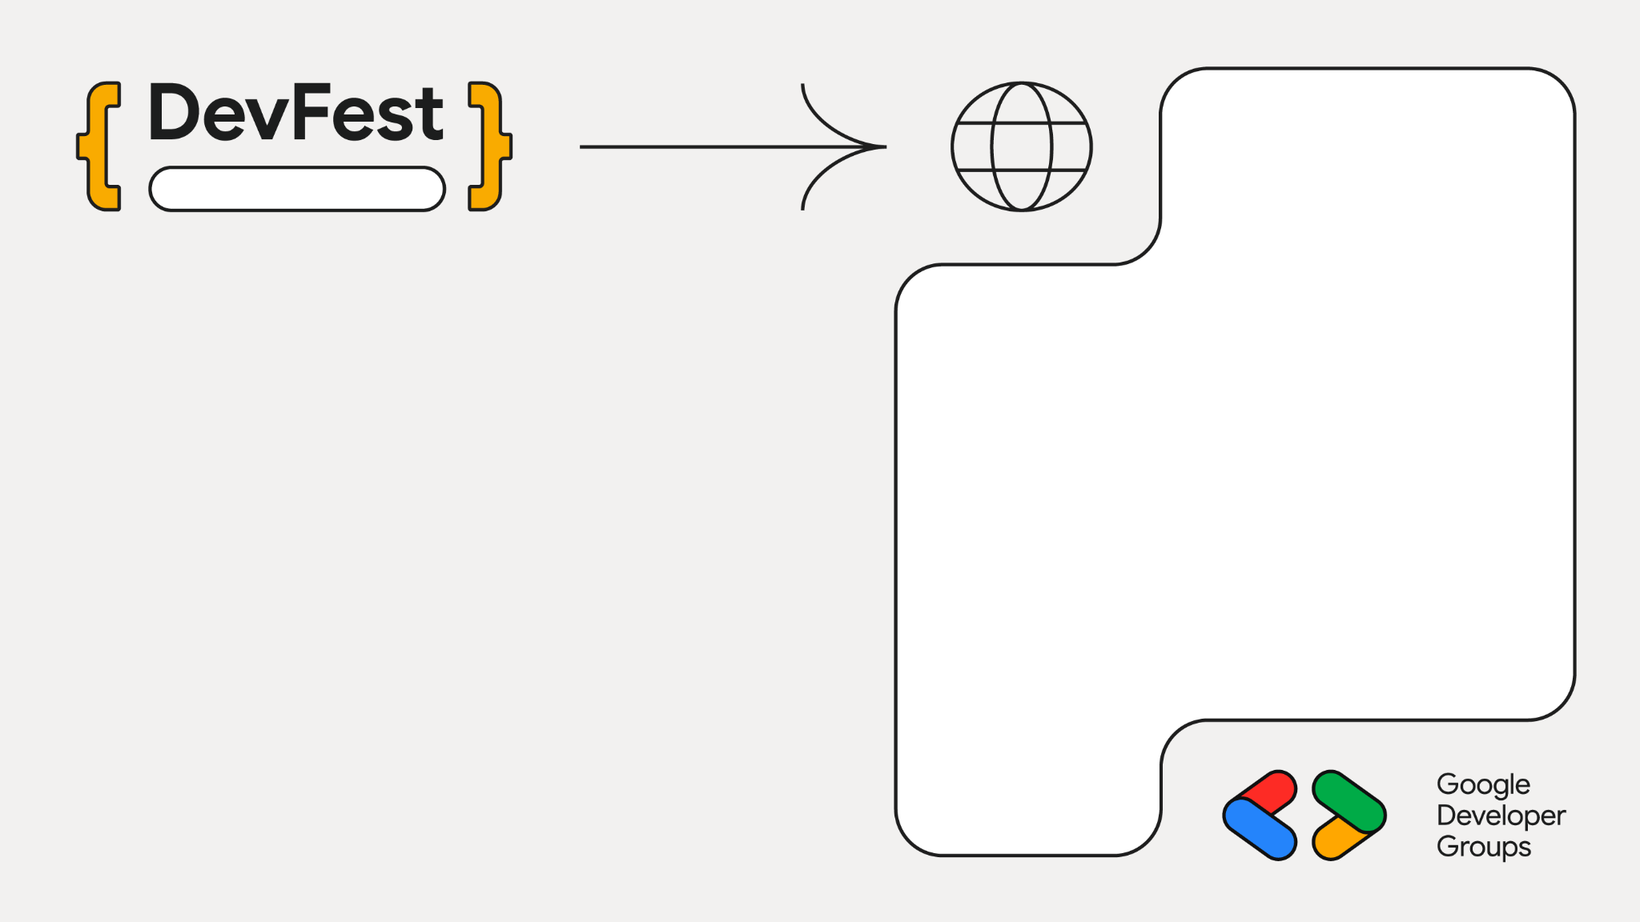
Naya Raipur
Staff Engg @ JioHotstar
Previously @ Intuit, Walmart, SAP
Expertise in Data, AI and Backend
~10 years in the Industry
GenAI Course Author
Mentor
Speaker
Mayur Madnani

Slide 3
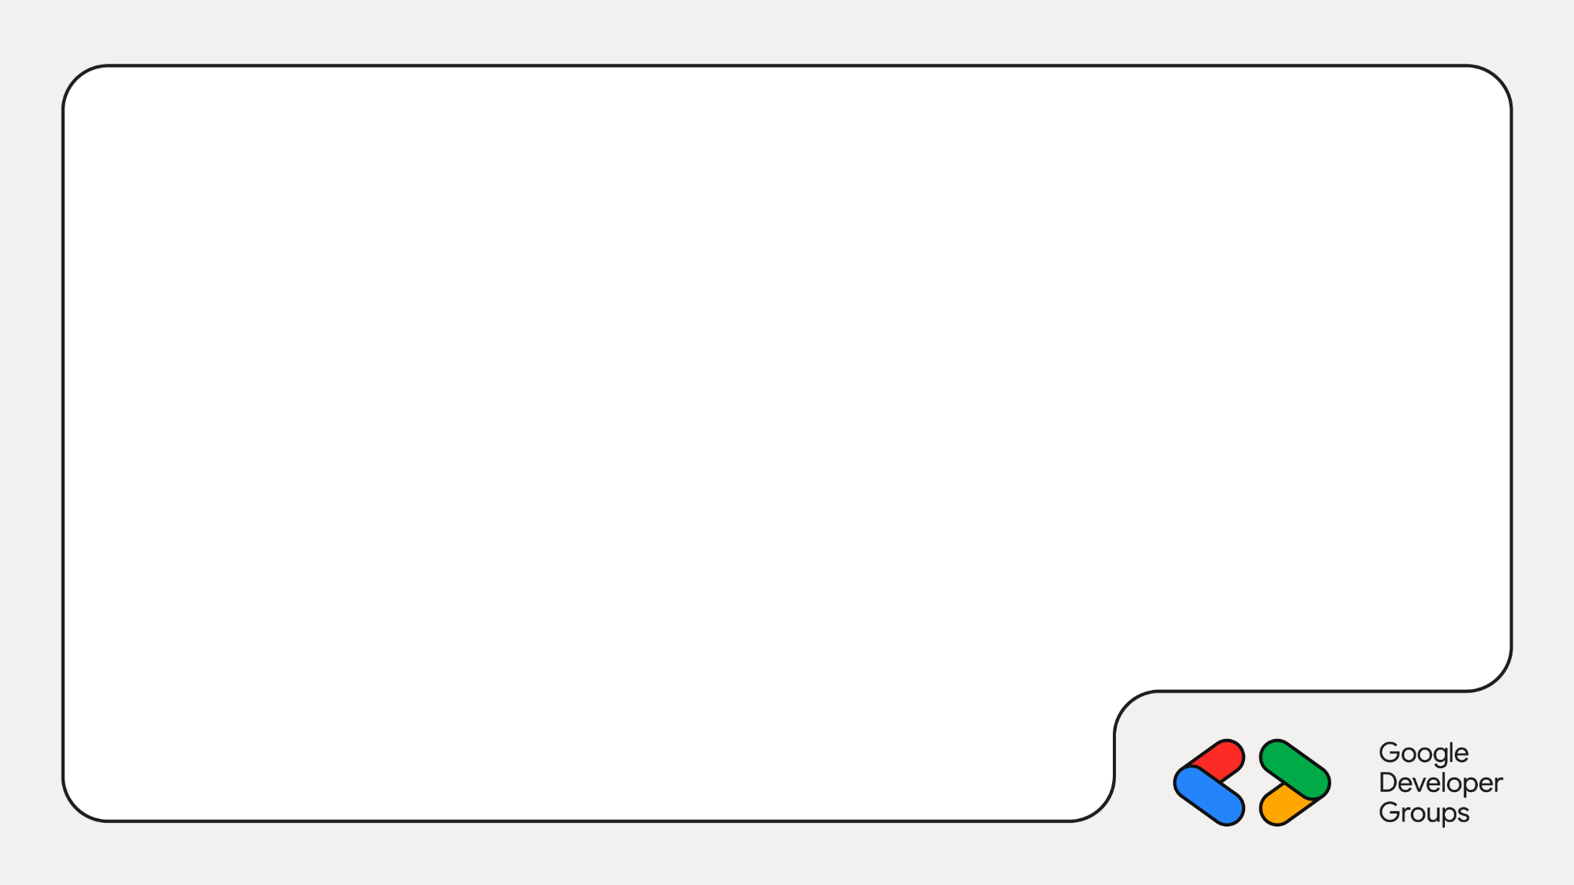
The NoteNinja Agent
Transform messy notes into markdown documentation automatically.
Input
Raw, unstructured notes and quick jotted-down thoughts
Model Processing
Gemma on Cloud Run intelligently parses and structures
Output
Markdown friendly documentation

Slide 4
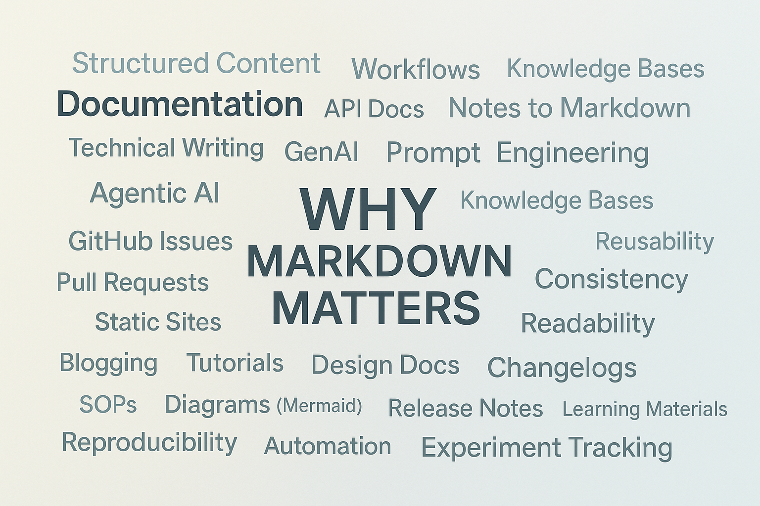

Slide 5
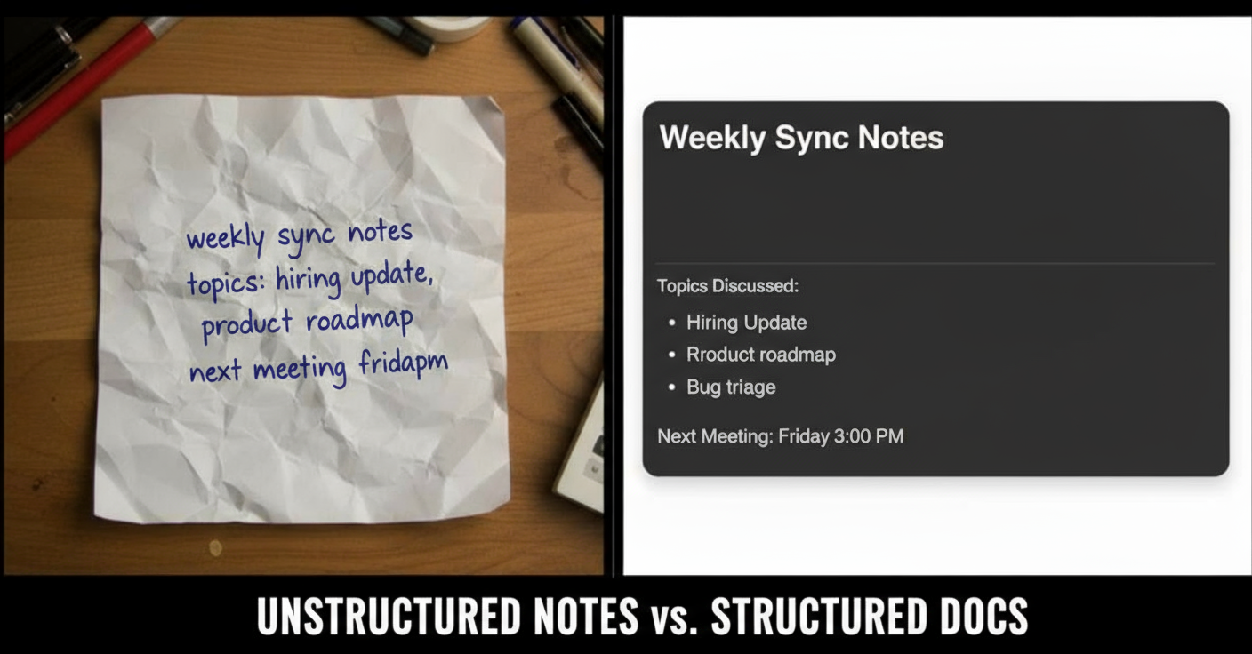

Slide 6
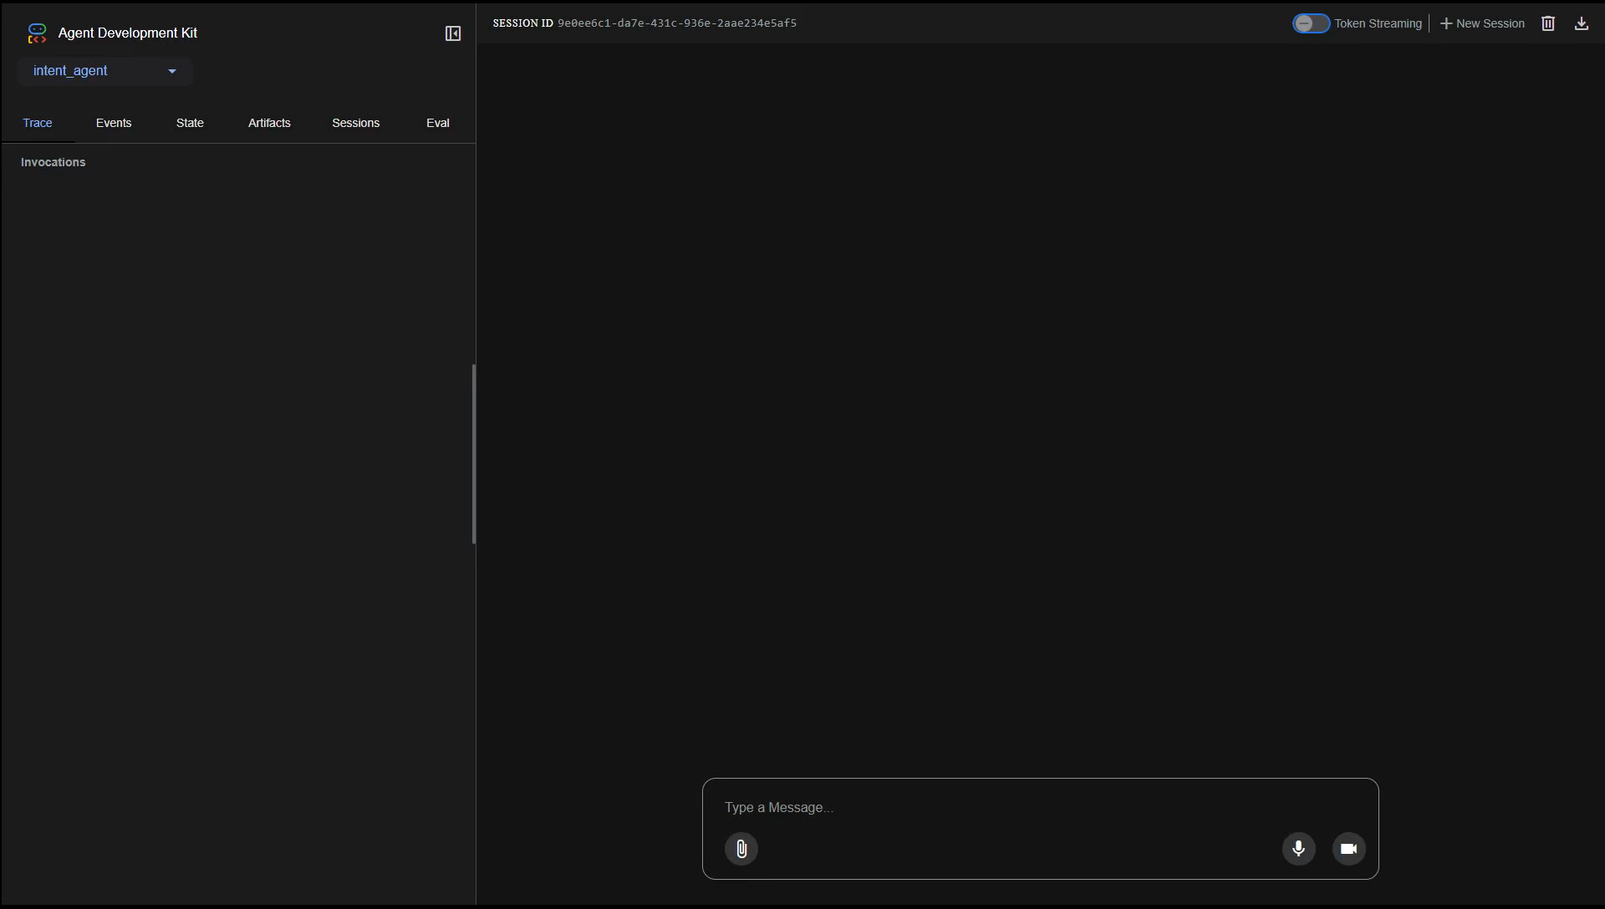
Demo

Slide 7
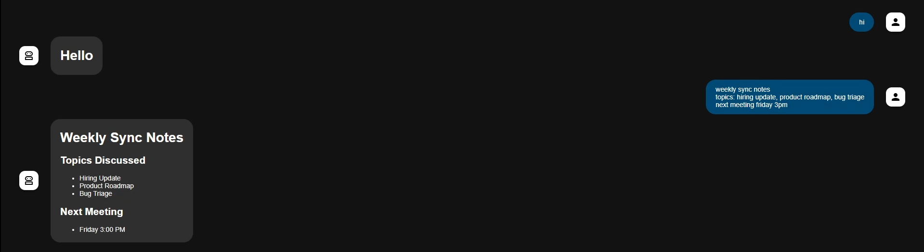
Demo

Slide 8
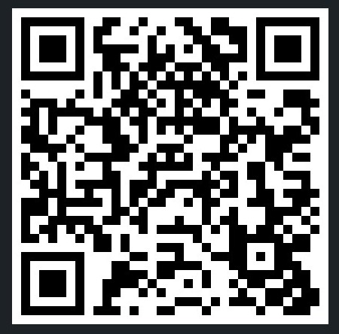
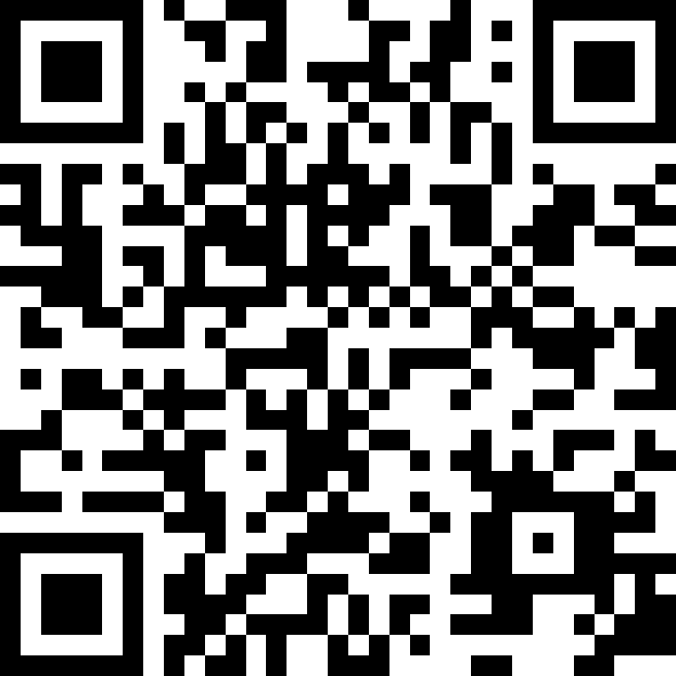
🌐linkedin.com/in/mayurmadnani
🌐github.com/mayurmadnani/workshop-gcp-intent-to-agents

